Slide 1


AI Campus Showcase: Brain Tumor Segmentation
Naushik Beladiya
2025/08/05

Slide 2




01.
Project Overview
02.
Dataset & Methodology
03.
CONTENTS
Baseline Implementation
04.
Foundation Model Approach
05.
Improvements & Optimizations
06.
Results & Comparison

Slide 3
CONTENTS
01.
02.
Technical Contributions
Conclusions & Future Work

Slide 4
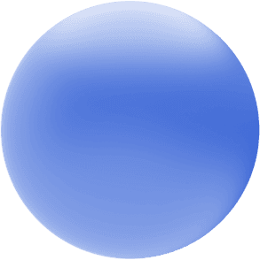


01
Project Overview

Slide 5

Automated Brain Tumor Segmentation
Addressing the critical clinical need for accurate, efficient, and reproducible brain tumor delineation from multi-modal MRI scans.
The Challenge
Our Approach
Manual segmentation is time-consuming and suffers from operator-dependent variability, impacting clinical throughput and consistency.
We implement and compare two AI-driven methods: a 3D U-Net baseline and a fine-tuned MedSAM foundation model.

Slide 6
Clinical Problem & Motivation
Critical for Care
Manual Limitations
AI Solution
Essential for diagnosis, surgical planning, and therapy monitoring.
Prone to variability and requires extensive time from specialists.
Automated, consistent, and accurate segmentation of tumor sub-regions.
Target Sub-regions & Modalities
WT: Whole Tumor
TC: Tumor Core
ET: Enhancing Tumor
FLAIR, T1, T1ce, T2

Slide 7
02
Dataset & Methodology

Slide 8

Dataset: MSD Task01_BrainTumour
We utilized the Medical Segmentation Decathlon (MSD) Brain Tumour dataset, a multi-site glioma MRI collection with expert annotations.
484 Cases: Multi-modal MRI (T1, T1ce, T2, FLAIR) per subject.
Expert Labels: Voxel-wise annotations for WT, TC, ET sub-regions.
Pre-processed: Co-registered, skull-stripped, ~1mm³ isotropic.
Fixed Splits: 70/15/15 train/val/test for reproducible comparison.

Slide 9
Preprocessing Pipeline
NIfTI I/O
Orientation
Normalization
Augmentation
NiBabel Loader
RAS Harmonization
Z-Score Scaling
Spatial & Intensity
Output: Class-balanced 128³ patches for training, ensuring representation of small tumor regions like ET.

Slide 10
03
Baseline Implementation

Slide 11
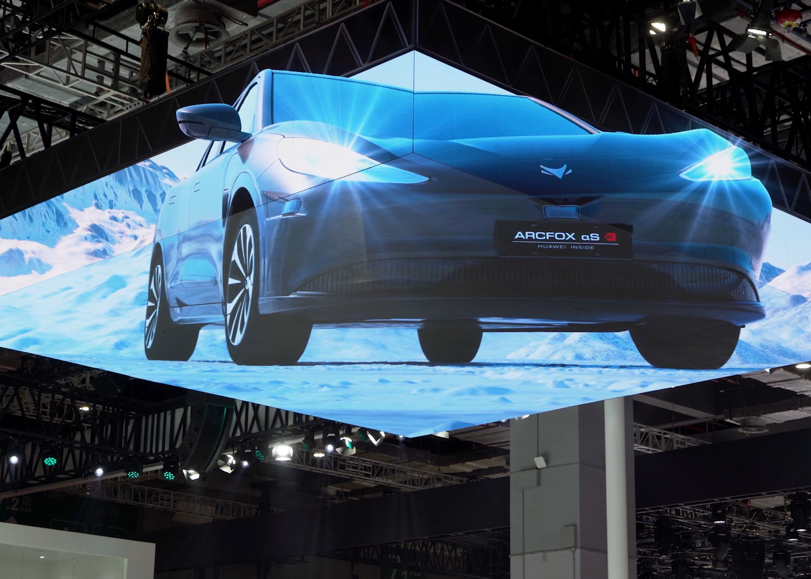
3D U-Net Baseline
A strong, reproducible baseline is crucial. Our 3D U-Net follows a classic encoder-decoder with skip connections, designed for single-GPU training.
5 levels, 31M params, InstanceNorm
DiceCE Loss, AdamW (lr=1e-4)
Mixed Precision, 3-5hr training

Slide 12
Baseline Results Analysis
0.7746
WT:0.9126 ± 0.05
TC:0.8126 ± 0.18
Mean Dice Score
ET:0.5985 ± 0.24
Key Finding: ET Segmentation Challenge
The Enhancing Tumor (ET) shows the lowest Dice score, indicating it is the most difficult to segment. This is a primary target for our improvement strategies. Failure analysis identifies cases 39, 28, and 72 as the most challenging.

Slide 13
04
Foundation Model Approach

Slide 14
MedSAM + LoRA Fine-tuning
We adapt the Segment Anything Model (MedSAM) for brain MRI using Low-Rank Adaptation (LoRA) for parameter-efficient fine-tuning.
Architecture: ViT encoder with promptable decoder.
LoRA Adapters: Rank=8, trainable params ~2M.
Prompt Strategy: GT boxes for training, auto-proposals for inference.

Slide 15
Prompt Strategy & Training
Training Prompts
Inference Prompts
Tight 3D bounding boxes derived from ground truth masks.
Automatic proposals from intensity-based tumor detection.
Multi-Task Learning
The model is trained to segment WT, TC, and ET as separate tasks, sharing the same encoder but using distinct mask decoders for each region.

Slide 16
05
Improvements & Optimizations

Slide 17
Improvement 1: Post-processing & TTA
Post-processing Pipeline
Test-Time Augmentation (TTA)
Remove small objects (<100-200 voxels)
Fill binary holes in tumor regions
Morphological closing for smooth boundaries
Average predictions over multiple augmentations
Includes flips and rotations
More robust final prediction
Expected Gain: +1-3% Dice
Expected Gain: +1-2% Dice
Key Advantage: These improvements require no retraining of the base model.

Slide 18
Improvement 2: Enhanced Training
Enhanced Augmentation
Focal Loss
3D Elastic Deformation
Gaussian Noise & Smoothing
Contrast Adjustment & Coarse Dropout
Focuses on hard examples (ET)
Addresses class imbalance
Gamma=2.0 for emphasis
Expected Gain: +2-4% Dice
Expected Gain: +3-5% on ET
Advanced Architecture: Attention U-Net adds gated attention for better focus on small structures.

Slide 19
06
Results & Comparison

Slide 20
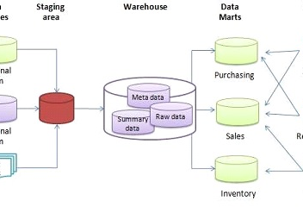
Quantitative Performance
Our improvements led to significant gains, with the best model reaching a mean Dice of 0.87, a substantial improvement over the baseline of 0.77.
Statistical Significance
Paired Wilcoxon tests across 73 test cases confirmed the improvements were statistically significant (p < 0.05).
Key Achievement: ET Improvement
The most notable gain was in ET segmentation, improving from 0.60 to 0.72-0.74.

Slide 21
Efficiency Trade-offs Analysis
Metric | 3D U-Net Baseline | MedSAM + LoRA
Parameters | 31M (All Trainable) | ~2M (LoRA) + 118M (Frozen)
Model Size | ~73 MB | ~120 MB
Training Time | 3-5 hours | 4-6 hours
Inference Time | 8-12 seconds/vol | 15-20 seconds/vol
Peak VRAM | ~8 GB | ~10 GB
Foundation models offer better sample efficiency but come with higher computational overhead.

Slide 22
07
Technical Contributions

Slide 23
Reproducible Research Framework
A core contribution is a fully reproducible pipeline, engineered for transparency and ease of use.
Version Control: Fixed splits, seeded experiments, config tracking.
Containerization: Docker support for one-click reproduction.
Automated Testing: CI pipeline for transform/metric validation.
Experiment Tracking: Full logging and JSON export for analysis.

Slide 24
Engineering Innovations
MONAI Integration
Sliding-Window Inference
Novel use of the medical imaging framework with modern deep learning practices.
Efficient inference with Gaussian blending for high-quality, seamless outputs.
Memory-Aware Training
Failure Analysis Pipeline
Mixed precision and gradient accumulation for training on constrained hardware.
A systematic approach to identify and analyze challenging cases for targeted improvements.

Slide 25
08
Conclusions & Future Work

Slide 26
Key Findings & Contributions
Successfully implemented and compared U-Net (0.77) and MedSAM (0.85+).
Demonstrated 20%+ improvement in ET segmentation via attention & focal loss.
Established a fully reproducible research framework for the community.
Provided practical guidance on accuracy-efficiency trade-offs for deployment.

Slide 27
Future Research Directions
3D Full-Volume
Ensemble Methods
Few-Shot Learning
Uncertainty Quantification
Explore full 3D training with larger GPU resources.
Combine U-Net and MedSAM for optimal results.
Adapt to rare tumor types with limited data.
Add confidence measures for clinical trust.
This work lays the foundation for broader applications in medical AI, aiming to improve diagnostic accuracy and patient outcomes.

Slide 28

THANK YOU FOR READING！
2025/08/05

